Slide 1
Project 1: Mental Health in Tech
Members
Keegan
Lishi
Loku
Jane
Notes:
Hi everyone, Welcome to our project for mental health in the tech industry.

Slide 2
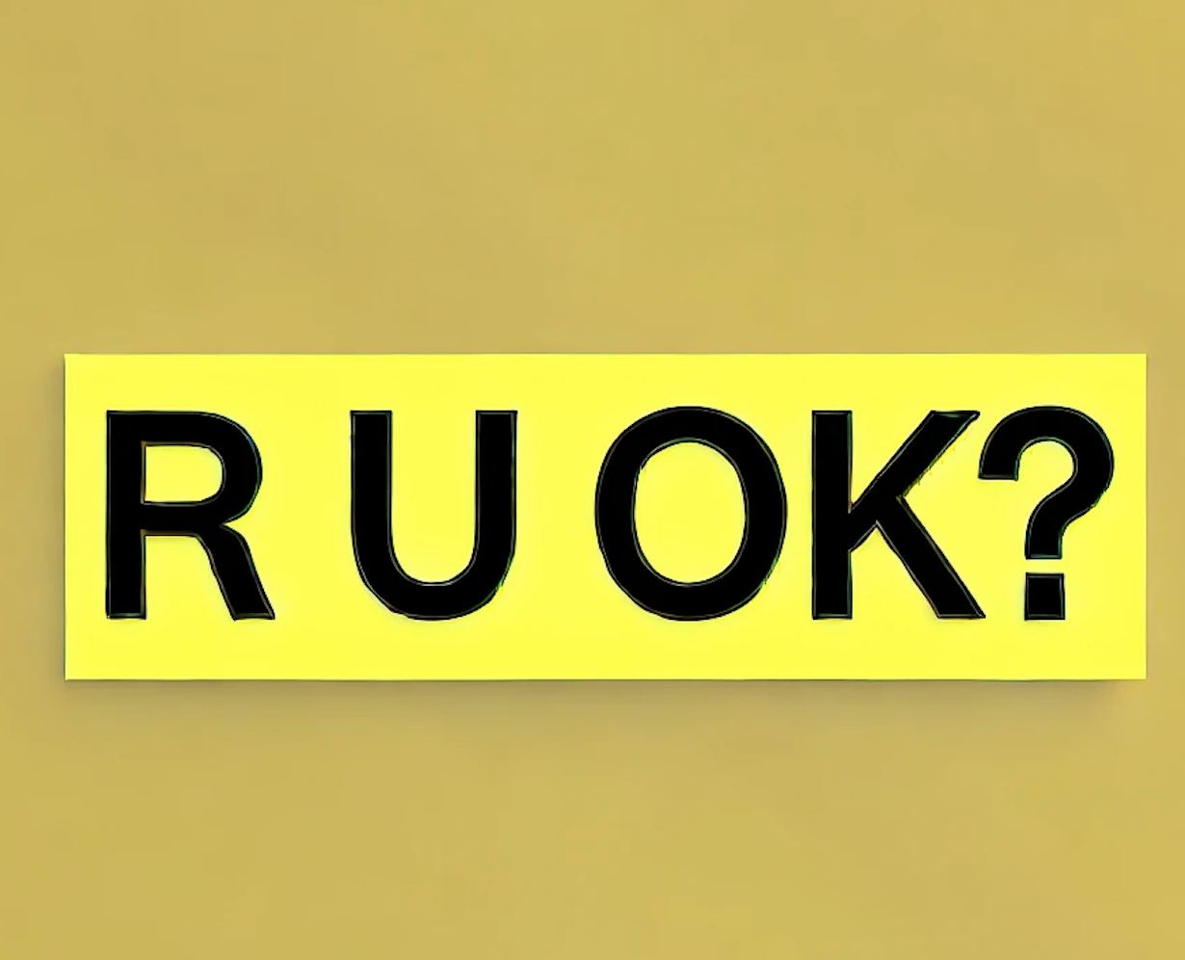
Background
Since 2009, every second Thursday of September is R U OK Day, a day to increase awareness and encourage conversations around mental health.
Notes:
A little bit of background of our project, Since 2009, every second Thursday of September is R U OK Day, a day to increase awareness and encourage conversations around mental health. And we wanted to see if mental health was being addressed in a 2016 survey of individuals who work in the tech industry.

Slide 3
Project Aim
Our project aims to uncover potential influences on mental health and treatment-seeking behavior in the tech industry.
Notes:
Our project aims to uncover potential influences on mental health and treatment-seeking behavior in the tech industry.

Slide 4
Questions
Does mental health interfere with work?
Do males seek mental health treatments less often than females in tech companies?
Is mental health more prevalent in different regions? Does US have a bigger issue with mental health compared to other countries?
How do employees perceive their workplace culture regarding mental health?
Notes:
Now in order to guide our analysis we asked the following questions
Does mental health interfere with work?
Do males seek mental health treatments less often than females in tech companies?
Is mental health more prevalent in different regions? Does US have a bigger issue with mental health compared to other countries?
How do employees perceive their workplace culture regarding mental health?

Slide 5
Question (Lishi):
Does mental health interfere with work?
1. General Survey Question: Do you think you have a mental disorder ?
2. Productivity Impact: Do you think your productivity is ever affected by mental health issues?
3. The extent of Impact: What percentage of your work time is affected by a mental health issue?
Notes:
Thanks, Keegan. Good evening, everyone. My question for our topic is: Does mental health interfere with work? I analysed three questions from the survey:
General Survey Question: Do you think you have a mental disorder?
If yes, then:
Productivity Impact: Do you think your productivity is ever affected by mental health issues?
If yes, then:
Extent of Impact: What percentage of your work time (time performing primary or secondary job functions) is affected by a mental health issue?

Slide 6
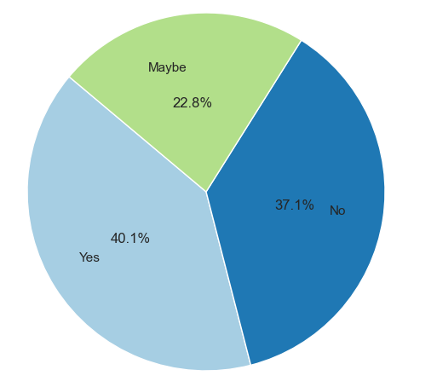
Have mental health disorder or not
Notes:
This pie chart answers the first question: Do you think you have a mental health disorder?
From the pie chart, we can see that about 40.1% responded "yes," 22.8% responded "maybe," and only 37.1% said "no." This suggests that mental health issues are more common than perceived.
The 22.8% who responded "maybe" reflects a level of uncertainty or lack of awareness regarding mental health disorders. This points to the need for more education and resources about mental health in the workplace.

Slide 7
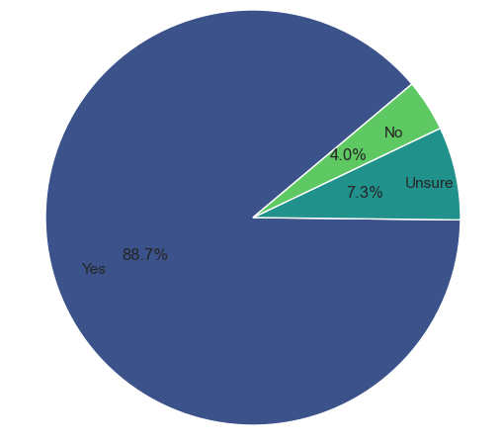
Believe productivity is affected by mental health issue
Yes: 88.7%
Notes:
Next, this pie chart addresses the second question: If you have or may have a mental health disorder, do you think your productivity is ever affected?
The results show that a significant majority of individuals with a mental disorder—almost 90%—believe their productivity is affected. Meanwhile, 7.3% are uncertain, and only 4.0% reported that it does not impact their productivity. This highlights that very few individuals feel unaffected by their mental health challenges.

Slide 8
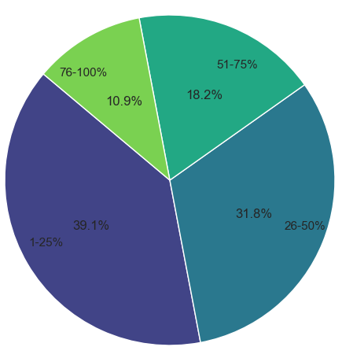
Work time% affected by a mental health issue
Severe (75-100%)
moderate to severe (51-75%)
39.1%
Moderate (25-50%)
Minimal (1-25%)
Notes:
Finally, regarding the last question about the extent to which mental health disorders interfere with work, the responses were as follows:
39.1% indicated minimal influence (1-25%)
31.8% reported moderate influence
18.2% mentioned moderate to severe influence
Approximately 10% believed that mental health disorders could substantially impact their work (76-100%).
This indicates that almost one-third of the workforce is significantly affected in terms of productivity.

Slide 9
Does mental health interfere with work?
Yes ,
Most people (around 90%) with mental health disorders indicated that their work is affected to varying degrees,
with about ⅓ reporting moderate to severe impacts
Notes:
To answer the main question: Does mental health interfere with work? The answer is yes; about 90% of people with mental health disorders suggested that their work is affected to varying degrees, with about one-third reporting moderate to severe impacts.
It is crucial to note that mental disorders are commonly occurring in tech surveys. It may be beneficial for tech companies to implement mental health initiatives such as wellness programs, mental health days, and access to counseling services.

Slide 10

Do males seek mental health treatments less often than females?
Notes:
Hello everyone, today I’ll be presenting one of our group's analysis on whether males seek mental health treatment less often than females in tech companies.Mental health issues are critical in the fast-paced tech industry, and understanding gender differences in seeking treatment can help improve support systems.Let’s begin by comparing mental health treatment seeking behavior between the U.S. and other countries.

Slide 11
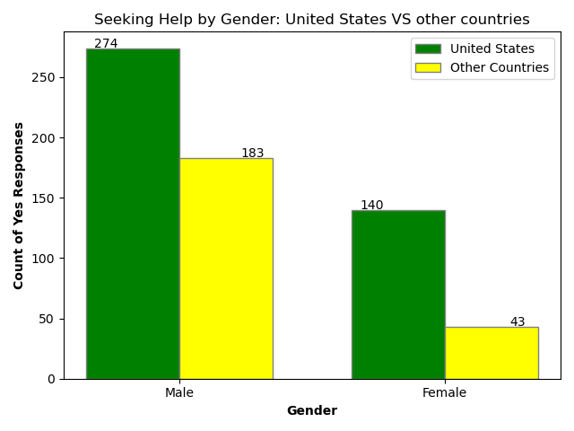
Notes:
This bar graph compares the number of males and females who sought mental health treatment, split between tech employees in the United States and other countries.In the United States, we see 274 males compared to 140 females seeking mental health treatment.In other countries, 183 males sought treatment, while only 43 females did.
This reveals a consistent pattern across regions where males are more likely to seek treatment than females.

Slide 12
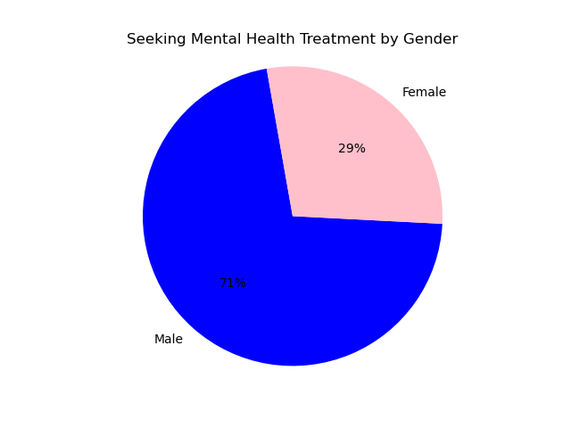
\
Notes:
This pie chart gives a broad, overall picture of the proportion of males and females who sought mental health treatment in the tech industry globally.
We can see that 71% of treatment seekers are male, while 29% are female.This aligns with what we saw in the regional breakdown: males are more likely to seek mental health treatment than females.
Do males seek mental health treatments less often than females? Answer is ‘No’
Across all our data, the graphs confirm that males in tech are significantly more likely to seek mental health treatment than females.
This trend highlights the need for tech companies to adopt more gender-sensitive mental health strategies.
Specifically, encouraging females to seek mental health care should be a priority to ensure equitable access to support.

Slide 13
Is mental health more prevalent in different regions?
Does US have a bigger issue with mental health compared to other countries?
Focus On
Seeking treatment?
Is help offered in workplaces?
Notes:
One of our main questions was: Is mental health more prevalent in different regions?
Does US have a bigger issue with mental health compared to other countries?
With this in mind we looked through various sections in our data and focused on individuals who sought out treatment
As well as individuals who have been diagnosed with a mental health condition by a medical profession, and whether or not they have support in their workplace.

Slide 14
Individuals seeking treatment
First we looked at individuals seeking treatment in general for mental health.
Were people getting their mental health checked?
Or were they not giving it a second thought?
Notes:
We first looked for individuals seeking treatment in general for mental health.
We wanted to know if people would get a general checkup to make sure that their mental health was okay.
Or if they didn’t check at all.

Slide 15
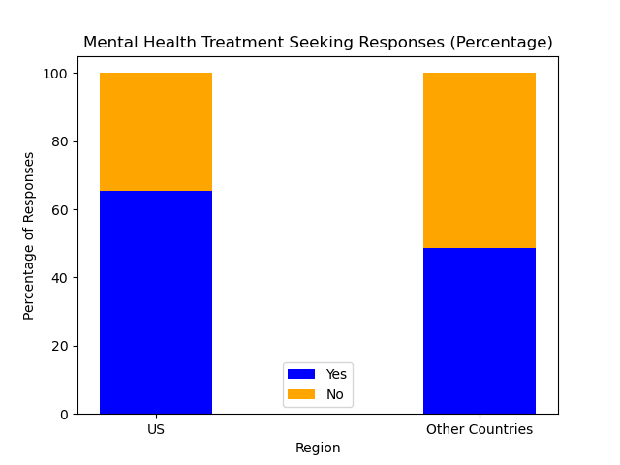
34.52%
51.26%
65.48%
48.74%
Notes:
Our data indicates that individuals in the USA are significantly more likely to seek mental health treatment, with 65.48% of responses indicating they have sought help compared to only 48.74% of individuals outside the USA. Specifically, in the USA, 550 individuals reported seeking treatment (Yes), while 289 did not (No). In contrast, 290 individuals outside the USA sought treatment, while 304 reported not seeking help.
This Visible difference suggests that mental health is prioritized more highly in the USA compared to other countries, highlighting cultural differences in the perception and importance of mental health care.
The higher percentage of treatment-seeking behavior in the USA may be influenced by factors such as greater public awareness, access to mental health resources, and reduced stigma surrounding mental health issues.

Slide 16
Workplaces that offer help
Looked for individuals who sought treatment
Were diagnosed by a medical professional.
Did these people recieve help within their workplace?
Notes:
From that we wanted to know of those individuals who sought treatment and were diagnosed by a medical professional.
And we wanted to find out whether these individuals received help within their workplace.

Slide 17
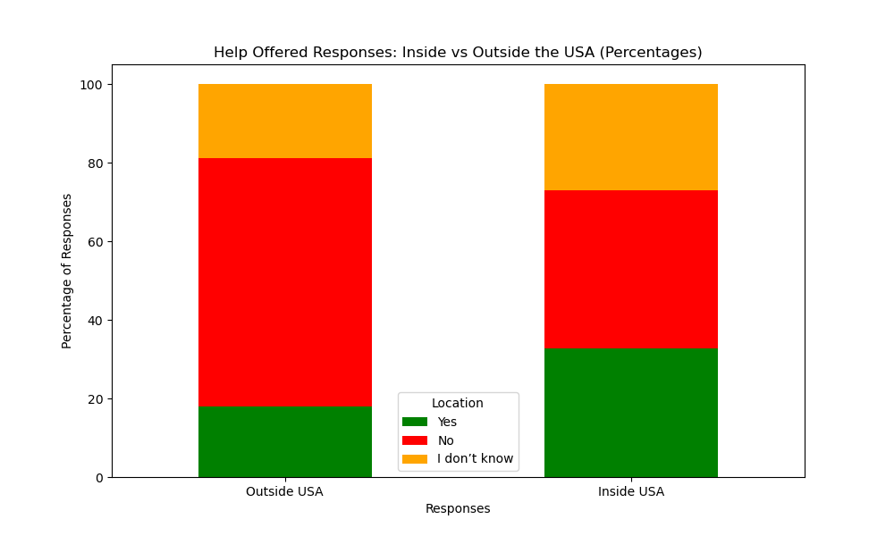
19%
27%
40%
63%
33%
18%
Notes:
In our findings of workplace mental health support, we found notable differences between responses in the USA and those from other countries.
In the USA, 33% reported that their workplace offers mental health support, while only 18% of respondents from outside the USA indicated the same.
However, it's important to note that 40% of respondents in the USA answered "No" to the question of whether their workplace provides mental health support, and 27% responded "I don't know." In contrast, among respondents from other regions, 63% answered "No," and 19% said "I don't know."
These findings suggest that while a significant portion of individuals in both regions are uncertain about or do not receive mental health support, the USA appears to place a greater emphasis on mental health initiatives in the workplace. This further reinforces a higher prioritization of mental health in the USA compared to other countries.
However, the data also highlights a concerning trend: despite having more workplace treatment options for mental health, the USA faces a larger issue with mental health challenges among its workforce.

Slide 18
Question
Are people willing to discuss the mental health issue now? And why?
Notes:
The question is are people willing to discuss the mental health issue now?

Slide 19
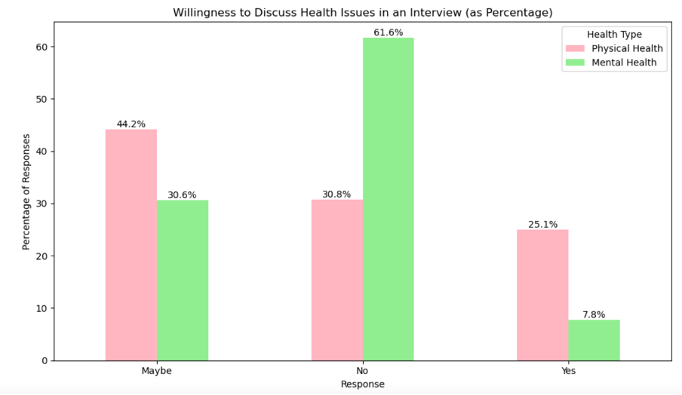
Mental v Physical Health
Notes:
There is a survey done in 2016 and the question is about people’s willingness to discuss physical health issue compared to mental health issue,
from the bar chart we could see
44% of people are somewhat willing to discuss physical health issues ("Maybe Yes").
25% are willing to discuss physical health openly ("Yes").
However
62% of people are unwilling to discuss mental health issues ("No").
Only 8% are willing to discuss mental health openly ("Yes").
So we could see although organizations are focusing on raising awareness through initiatives like Are You Okay Day, people are still far more comfortable discussing physical health than mental health.

Slide 20
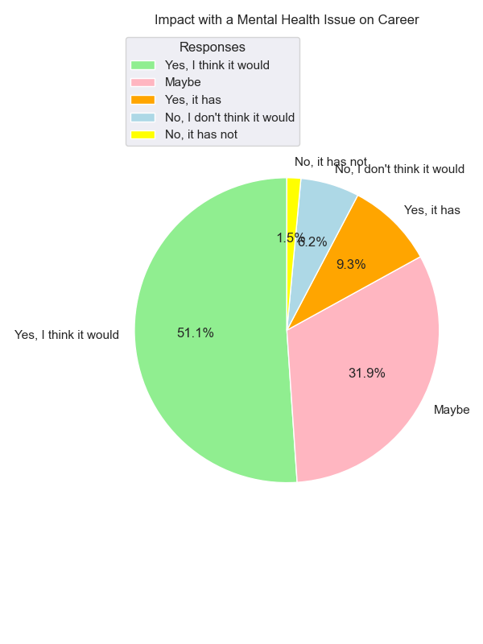
Impact of Being Identified With a Mental Health Issue on Career
Notes:
A survey question about the impact of being identified with a mental health issue on one's career is designed to uncover the reasons why people may be reluctant to discuss mental health.
51% of respondents firmly believe mental health issues could impact careers and 32% believe the health issue may impact careers.
However, Only 10 % (9% + 1.5%) report actual negative career impacts.
A significant majority of people perceive mental health issues as a potential threat to career progression, which may lead to hesitation in disclosing mental health concerns.
However, there is a clear discrepancy between perception and reality. While many people have concern about career progression, the actual number of those affected is much lower.

Slide 21

Reducing Mental Health Stigma in the Workplace
Notes:
Understanding the stigma surrounding mental health is crucial, as it remains a significant barrier to open discussions and support. Many individuals still hold the belief that mental health challenges can negatively impact their careers, which reflects the ongoing stigma that persists in professional environments.
As Keegan mentioned before, there is increasing support from the employers now.
By fostering supportive environments in the workplace, organizations can help employees feel more comfortable seeking help, ultimately promoting a healthier, more inclusive, and productive work culture.

Slide 22
Conclusion
Stigma and Openness: organizations must foster a culture of support.
Gender Disparities: need for gender-sensitive mental health strategies.
Access vs. Effectiveness: Higher availability of mental health support does not equate to better outcomes
Impact on Productivity: Many employees report that mental health challenges affect their productivity
Comprehensive Approach Needed: Organizations should prioritize awareness, reduce stigma, and provide accessible resources for a healthier workplace culture
Notes:
The analysis of mental health in the workplace, particularly within the tech industry, reveal a complex landscape characterized by significant disparities, prevalent stigma, and the urgent need for comprehensive support systems.
Firstly, there is a notable reluctance to discuss mental health issues, This highlights a persistent stigma that organizations must address to foster a culture of openness and support.
Secondly, gender disparities in seeking mental health treatment are evident, as males are more likely to pursue help than females. This suggests the need for gender-sensitive strategies within organizations to encourage all employees to access mental health resources.
Additionally, despite the higher availability of workplace mental health support, the USA still faces significant mental health challenges, indicating that access alone is insufficient without addressing underlying issues and stigma.
Finally, high amounts of employees believe their productivity is affected. This shows thel need for tech companies to implement mental health initiatives, such as wellness programs and counseling services, to create supportive environments that enhance employee well-being and productivity.
To summarize, addressing mental health in the workplace requires a multifaceted approach that includes raising awareness, reducing stigma, and providing accessible resources. By prioritizing mental health, organizations can foster a healthier, more inclusive workplace culture that ultimately benefits both employees and the overall productivity of the organization.

Slide 23
Thanks for your time

